Slide 1

CS1020 Data Structures and Algorithms I Lecture Note #16
File Processing

Slide 2
Objective
Input/output on files: reading input from a file and writing data to a file.

Slide 3
References
Book
CS1020 website → Resources → Lectures
http://www.comp.nus.edu.sg/ ~cs1020/2_resources/lectures.html
Chapter 1, Section 1.8, pages 80 to 92
[CS1020 Lecture 16: File Processing]

Slide 4
Outline
0. Recapitulation
File Input
1.1 File Objects
1.2 Reading File
1.3 Input Tokens
1.4 Tokenizing a String
1.5 Exercise: Runners
File Output
2.1 PrintStream
2.2 System.out and PrintStream
2.3 Exercise: Runners (revisit)
Input and Output Streams
3.1 InputStream and OutputStream
3.2 Examples
[CS1020 Lecture 16: File Processing]

Slide 5
0. Recapitulation
We far we have been using the Scanner class to do interactive input.
We have also been using the UNIX input redirection < to redirect data from a file, and output redirection > to redirect data to a file.
< and > are UNIX features, not Java’s.
Now, we will explore how to create File objects in Java.
[CS1020 Lecture 16: File Processing]

Slide 6
1 File Input

Slide 7
1.1 File Objects (1/2)
The API File class represents files
In java.io package
Creating a File object does not actually create that file on your drive
Some methods in File class:
Method | Description
boolean canRead() | Tests whether the application can read the file
boolean canWrite() | Tests whether the application can modify the file
boolean delete() | Deletes the file or directory
boolean exists() | Tests whether the file or directory exists
String getName() | Returns the name of the file or directory
long length() | Returns the length (in bytes) of the file
[CS1020 Lecture 16: File Processing]

Slide 8
1.1 File Objects (2/2)
Example:
File f = new File("myfile");
if (f.exists() && f.length() > 2048) {
f.delete();
}
Path
Absolute path
Specify a drive or start with the root (/) directory
Eg: "C:/Documents/CS1020/data"
Relative path
With respect to where the program resides
Eg: "input/eels3.in"
[CS1020 Lecture 16: File Processing]

Slide 9
1.2 Reading a File (1/3)
Pass a File reference when constructing a Scanner object
FileExample1.java
import java.util.*;
import java.io.*;
public class FileExample1 {
public static void main(String[] args)
throws FileNotFoundException {
Scanner infile = new Scanner(new File("example"));
int sum = 0;
while (infile.hasNextInt()) {
sum += infile.nextInt();
}
System.out.println("Sum = " + sum);
}
File “example”:
Output:
2 7 -3 9 1
Sum = 16
[CS1020 Lecture 16: File Processing]

Slide 10
1.2 Reading a File (2/3)
FileExample2.java
import java.util.*;
import java.io.*;
public class FileExample2 {
public static void main(String[] args)
throws FileNotFoundException {
try {
Scanner infile = new Scanner(new File("example"));
int sum = 0;
while (infile.hasNextInt()) {
sum += infile.nextInt();
}
System.out.println("Sum = " + sum);
}
catch (FileNotFoundException e) {
System.out.println("File 'example' not found!");
}
}
[CS1020 Lecture 16: File Processing]

Slide 11
1.2 Reading a File (3/3)
FileExample3.java
import java.util.*;
import java.io.*;
public class FileExample2 {
public static void main(String[] args)
throws FileNotFoundException {
File f = new File("example");
if (!f.exists()) {
System.out.println("File 'example' does not exist!");
System.exit(1);
}
Scanner infile = new Scanner(f);
int sum = 0;
while (infile.hasNextInt()) {
sum += infile.nextInt();
}
System.out.println("Sum = " + sum);
}
}
[CS1020 Lecture 16: File Processing]

Slide 12
1.3 Input Tokens (1/3)
Input data are broken into tokens when read.
Scanner view all input as a stream of characters, which it processes with its input cursor
Each call to extract the next input (next(), nextInt(), nextDouble(), etc.) advances the cursor to the end of the current token
Tokens are separated by whitespace
[CS1020 Lecture 16: File Processing]

Slide 13
1.3 Input Tokens (2/3)
InputTokens.java
import java.util.*;
import java.io.*;
public class InputTokens {
public static void main(String[] args)
throws FileNotFoundException {
Scanner infile = new Scanner(new File("tokens"));
int a = infile.nextInt()
String b = infile.next();
String c = infile.nextLine();
double d = infile.nextDouble();
System.out.println("a = " + a); System.out.println("b = " + b);
System.out.println("c = " + c); System.out.println("d = " + d);
}
}
File “tokens”:
(viewed on screen)
123 CS1020 Data Structures and Algorithms 1
456 78.9
(internally)
123 CS1020 Data Structures and Algorithms 1\n456 78.9\n
[CS1020 Lecture 16: File Processing]

Slide 14
1.3 Input Tokens (3/3)
int a = infile.nextInt();
String b = infile.next();
String c = infile.nextLine();
double d = infile.nextDouble();
System.out.println("a = " + a);
System.out.println("b = " + b);
System.out.println("c = " + c);
System.out.println("d = " + d);
a = 123
b = CS1020
c = Data Structures and Algorithms 1
d = 456.0
File “tokens”:
123 CS1020 Data Structures and Algorithms 1\n456 78.9\n
↑
After int a = infile.nextInt();
123 CS1020 Data Structures and Algorithms 1\n456 78.9\n
After String b = infile.next();
123 CS1020 Data Structures and Algorithms 1\n456 78.9\n
After String c = infile.nextLine();
123 CS1020 Data Structures and Algorithms 1\n456 78.9\n
After double d = infile.double();
123 CS1020 Data Structures and Algorithms 1\n456 78.9\n

[CS1020 Lecture 16: File Processing]

Slide 15
1.4 Tokenizing a String
A Scanner can tokenize a string
StringTokenize.java
import java.util.*;
import java.io.*;
public class StringTokenize {
public static void main(String[] args) {
String msg = "345 students in CS1020.";
Scanner sc = new Scanner(msg);
int a = sc.nextInt()
String b = sc.next();
String c = sc.nextLine();
System.out.println("a = " + a);
System.out.println("b = " + b);
System.out.println("c = " + c);
}
}

[CS1020 Lecture 16: File Processing]

Slide 16
1.5 Exercise: Runners (1/4)
Write a program to read in the distances run by a group of runners
Sample input file “runners_data”:
Runner ID (type int), name (String, a single word), followed by a list of distances in km (type double)
You may assume that there are at least one runner and each runner has at least one distance record
123 Charlie 6.5 5.2 7.8 5.8 7.2 6.6 9.2 7.2
987 Alex 12.8
312 Jenny 5.7 4 6.2
509 Margaret 3.1 3.4 3.2 3.1 3.5
610 Richard 11.2 13.2 10.8 9.5 15.8 12.4
[CS1020 Lecture 16: File Processing]

Slide 17
1.5 Exercise: Runners (2/4)
RunnersFlawed.java
import java.util.*;
import java.io.*;
public class RunnersFlawed {
public static void main(String[] args)
throws FileNotFoundException {
Scanner infile = new Scanner(new File("runners_data"));
int count = 0; double totalDist = 0.0;
while (infile.hasNext()) {
infile.nextInt(); // read ID
infile.next(); // read name
while (infile.hasNextDouble()) {
count++;
totalDist += infile.nextDouble();
}
}
System.out.printf("Total distance = %.2f\n", totalDist);
System.out.printf("Average distance per run = %.2f\n",
totalDist/count);
}
}
Exception in thread "main" java.util.InputMismatchException
at java.util.Scanner.throwFor(Scanner.java:864)
at java.util.Scanner.next(Scanner.java:1485)
at java.util.Scanner.nextInt(Scanner.java:2117)
at java.util.Scanner.nextInt(Scanner.java:2076)
at RunnersFlawed.main(RunnersFlawed.java:14)
[CS1020 Lecture 16: File Processing]

Slide 18
1.5 Exercise: Runners (3/4)
What went wrong?
RunnersFlawed.java
int count = 0; double totalDist = 0.0;
while (infile.hasNext()) {
infile.nextInt(); // read ID
infile.next(); // read name
while (infile.hasNextDouble()) {
count++;
totalDist += infile.nextDouble();
}
}
123 Charlie 6.5 5.2 7.8 5.8 7.2 6.6 9.2 7.2
987 Alex 12.8
312 Jenny 5.7 4 6.2
509 Margaret 3.1 3.4 3.2 3.1 3.5
610 Richard 11.2 13.2 10.8 9.5 15.8 12.4

[CS1020 Lecture 16: File Processing]

Slide 19
1.5 Exercise: Runners (4/4)
Solution: read line by line, then read tokens from each line.
RunnersCorrected.java
// Earlier portion omitted for brevity
Scanner infile = new Scanner(new File("runners_data"));
int count = 0; double totalDist = 0.0;
while (infile.hasNextLine()) {
String line = infile.nextLine();
Scanner sc = new Scanner(line);
sc.nextInt(); // read ID
sc.next(); // read name
while (sc.hasNextDouble()) {
count++;
totalDist += sc.nextDouble();
}
}
// Later portion omitted for brevity
Total distance = 173.40
Average distance per run = 7.54
[CS1020 Lecture 16: File Processing]

Slide 20
2 File Output

Slide 21
2.1 PrintStream (1/2)
In java.io package
PrintStream: An object that allows you to print output to a file
Any methods you have used on System.out (such as println()) will work on a PrintStream
PrintStream name = new PrintStream(new File("filename"));
Example:
PrintStream ps = new PrintStream(new File("greetings"));
ps.println("Hello world!");
ps.println("The quick brown fox jumps over the lazy dog.");
[CS1020 Lecture 16: File Processing]
Materials from Pearson

Slide 22
2.1 PrintStream (2/2)
PrintStream name = new PrintStream(new File("filename"));
If the file does not exist, it is created.
If the file already exists, it is overwritten.
Note: Do NOT open the same file for reading (Scanner) and writing (PrintStream) at the same time
You will overwrite the input file with an empty file
[CS1020 Lecture 16: File Processing]
Materials from Pearson

Slide 23
2.2 System.out and PrintStream
System.out is actually a PrintStream
A reference to it can be stored in a PrintStream variable
Printing to that variable causes console output to appear
PrintStream out1 = System.out;
PrintStream out2 = new PrintStream(new File("data.txt"));
out1.println("Hello, console!"); // goes to console
out2.println("Hello, file!"); // goes to file
[CS1020 Lecture 16: File Processing]
Materials from Pearson

Slide 24
2.3 Exercise: Runners (revisit)
Modify RunnersCorrected.java to send its output to the file “running_stat”.
RunnersOutfile.java
import java.util.*;
import java.io.*;
public class RunnersOutfile {
public static void main(String[] args)
throws FileNotFoundException {
Scanner infile = new Scanner(new File("runners_data"));
// code omitted for brevity
PrintStream outfile = new PrintStream(new File("running_stat"));
outfile.printf("Total distance = %.2f\n", totalDist);
outfile.printf("Average distance per run = %.2f\n",
totalDist/count);
outfile.close();
}
}
[CS1020 Lecture 16: File Processing]

Slide 25
3 Input and Output Streams

Slide 26
3.1 InputStream and OutputStream (1/2)
InputStream and OutputStream are abstractions of the different ways to input and output data
That is, it doesn’t matter if the stream is a file, a web page, a video, etc.
All that matters is that you receive information from the stream or send information into the stream.
InputStream is an abstract superclass that provides a minimal programming interface and a partial implementation of input streams. It defines methods for reading bytes, arrays of bytes, etc.
OutputStream is an abstract superclass that provides a minimal programming interface and a partial implementation of output streams. It defines methods for writing bytes or arrays of bytes to the stream.
[CS1020 Lecture 16: File Processing]

Slide 27
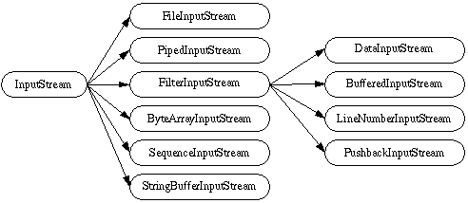
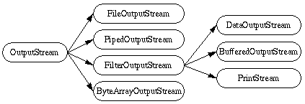
3.1 InputStream and OutputStream (2/2)
[CS1020 Lecture 16: File Processing]

Slide 28
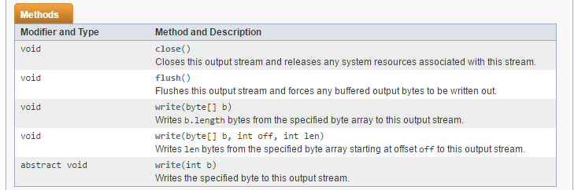
3.2 Example: Using OutputStream
We will use some of the methods in OutputStream below:
[CS1020 Lecture 16: File Processing]

Slide 29
3.2 Example: Using OutputStream
TestOutputStream.java
import java.io.*;
public class TestOutputStream {
public static void main(String[] args) throws IOException {
String msg = new String("Hello world!");
OutputStream out = new FileOutputStream("msg_file");
byte[] bytes = msg.getBytes();
out.write(bytes);
out.write(bytes[1]);
out.write(10); // ASCII value of newline
out.write(bytes, 3, 5);
out.close();
}
}
javac TestOutputStream.java
java TestOutputStream
cat msg_file
Hello world!e
lo wo
[CS1020 Lecture 16: File Processing]

Slide 30
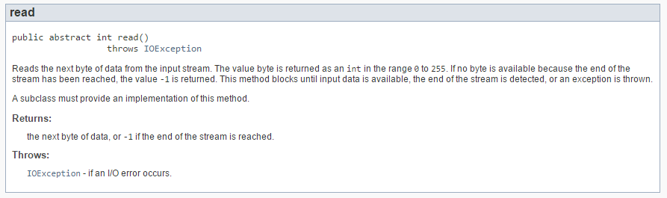
3.2 Example: Using InputStream
[CS1020 Lecture 16: File Processing]

Slide 31
3.2 Example: Using InputStream
TestInputStream.java
import java.io.*;
public class TestInputStream {
public static void main(String[] args) throws IOException {
InputStream in = new FileInputStream("msg_file"));
int value;
while ((value = in.read()) != -1) {
System.out.print((char)value);
}
System.out.println();
in.close();
}
}
javac TestInputStream.java
java TestInputStream
Hello world!e
lo wo
[CS1020 Lecture 16: File Processing]

Slide 32
End of file

